Slide 1


Effectiveness of Different Human-AI System Architectures
Aditya Singh, Zoe Szajnfarber

Slide 2
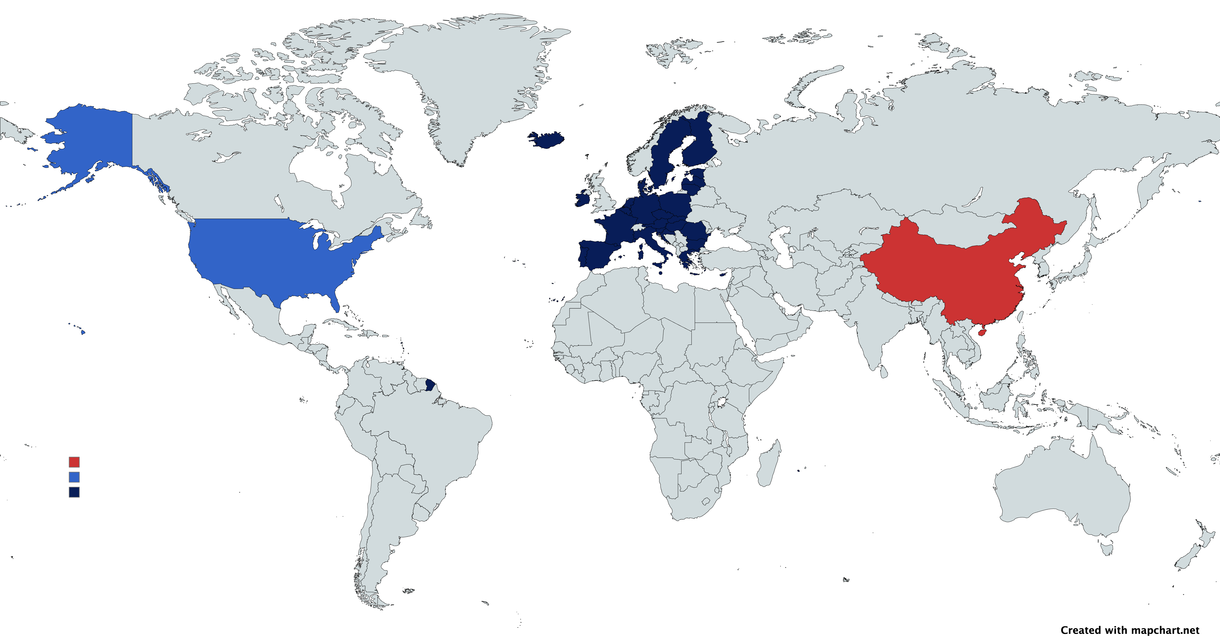
Human Control for Safety-Critical AI
EU AI Act:
“High-risk AI systems shall be designed and developed in such a way … that they can be effectively overseen by natural persons during [operation]”
DoD Directive 3009.09:
“allow commanders and operators to exercise appropriate levels of human judgment over the use of force”
China Academy of Information and Communications Technology:
“ensure that the system can … be quickly taken over by professional staff

Slide 3
Lack of Clarity on ”Human Control”

Slide 4


Research Goals
Categorize the ways that humans and AI can be partnered together
Apply these architectures to the Silverfish Passage System to understand tradeoffs

Slide 5
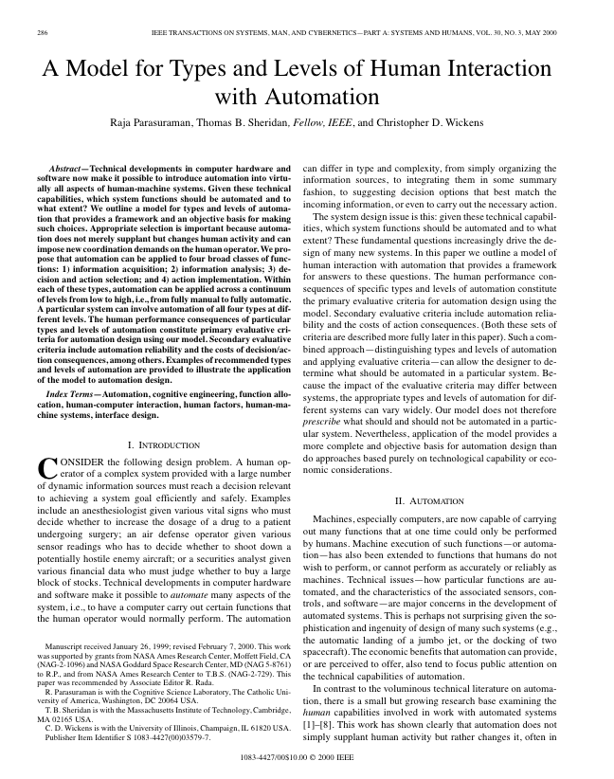
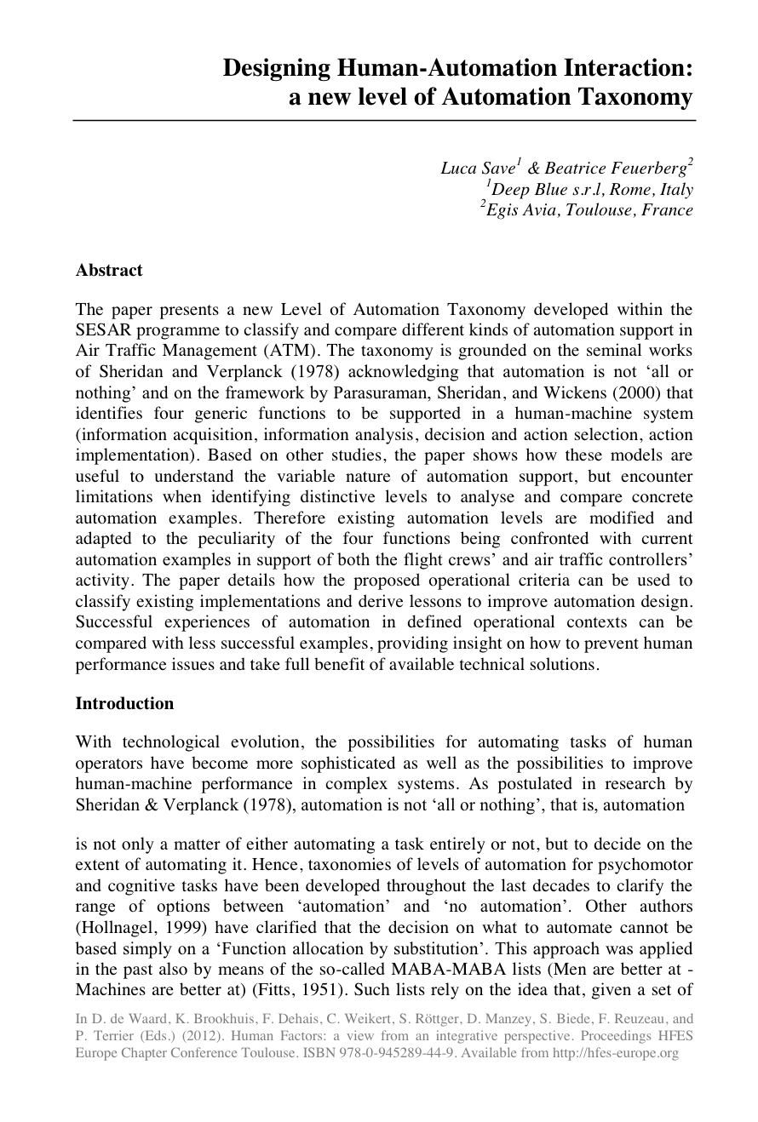


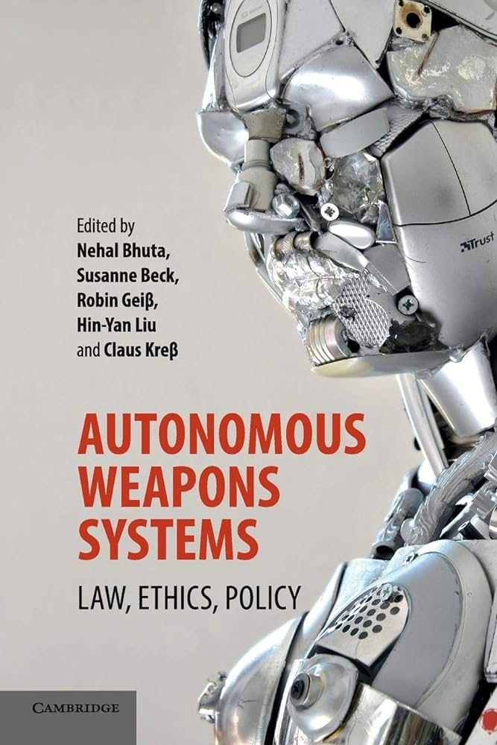




Framework: Meta-Analysis of Existing Frameworks
Frameworks from human-robot, human-computer, systems engineering, and technology ethics literature
Government agency developed frameworks
Industry trade group and corporate frameworks

Slide 6
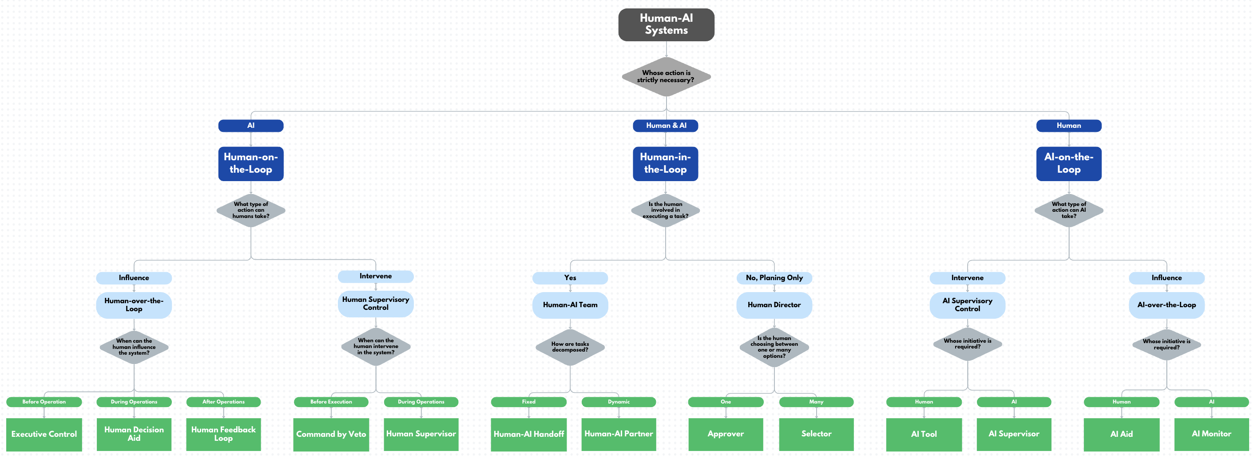
Our Framework

Slide 7
Three Key Paradigms
Human Supervising AI
Human-AI Teaming
AI Supervising Humans

Slide 8
Human Supervisory Control

Slide 9
AI Supervisory Control

Slide 10
Human-AI Teaming

Slide 11
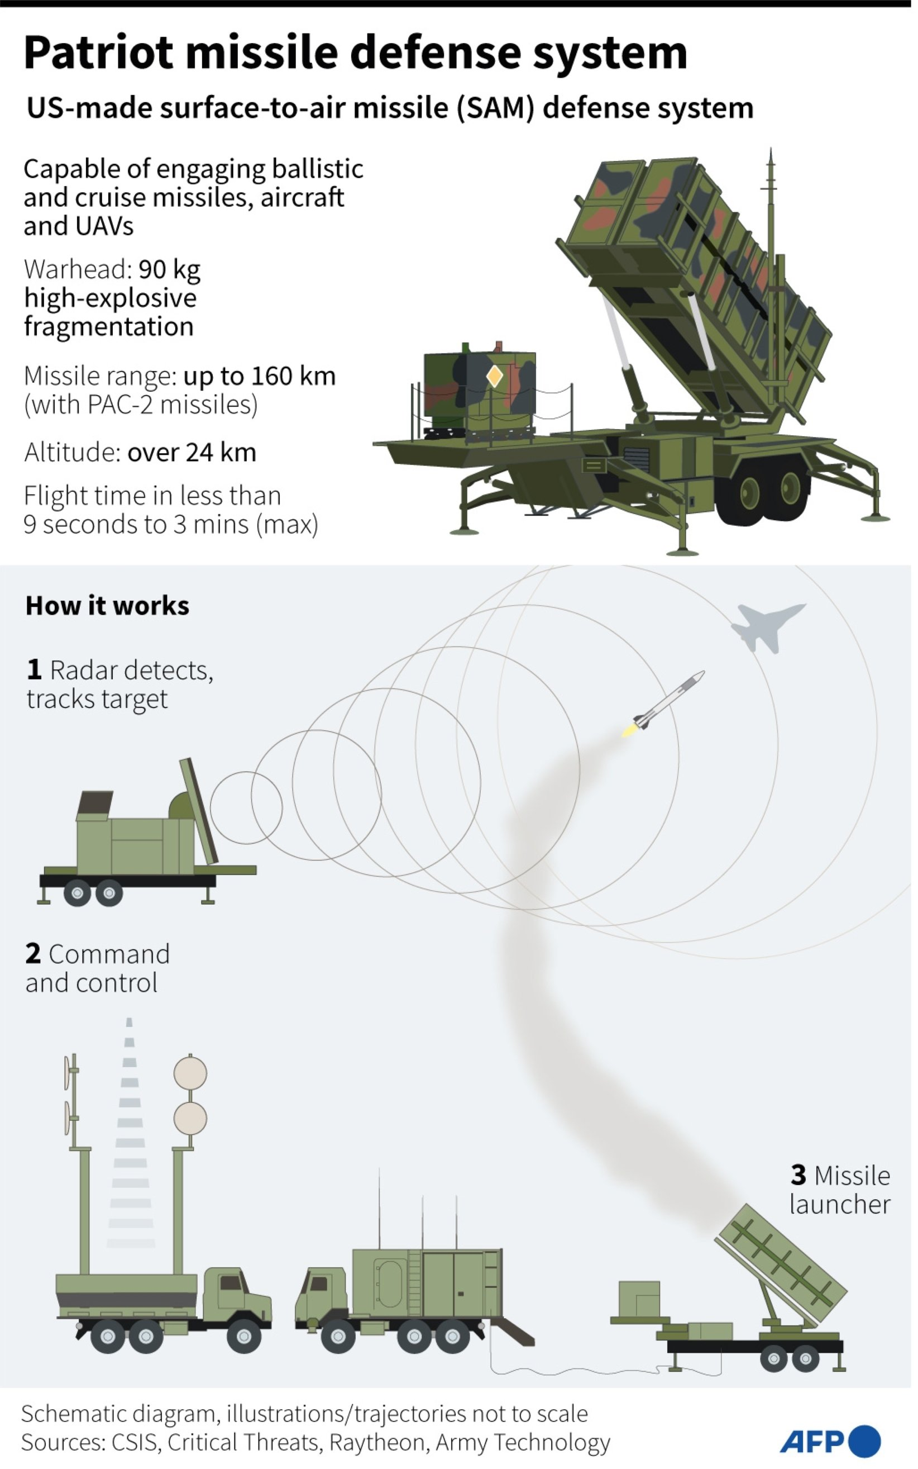


Patriot Missile Defense System Example
Semi-Automatic Mode
HITL
Human Approver
Human operator must authorize engagement or system will not fire
Automatic Mode
HOTL
Command by Negation
Optional Involvement
Adapted from the work of John K. Hawley, engineering psychologist with the U.S. Army Research Laboratory’s Human Research and Engineering Directorate and principal investigator for an Army effort to examine the human role in Patriot fratricides during the Iraq War.

Slide 12
Example Continued: Architectural Tradeoffs
Human has a clear point of intervention
AI can perform without delay in the rest of the loop
Tendency for human to agree with AI
HITL
Human Approver
Human operator must authorize engagement or system will not fire
AI can perform without any delay, which may be preferable in high intensity situations
High monitoring burden for human who may be asked to actively monitor entire loop
HOTL
Command by Negation
Optional Involvement

Slide 13
Example Continued: Collapse of Architectural Tradeoffs
Human approvers are shown to often approve every AI recommendation, without seeking their own evidence
HITL
Human Approver
Human operator must authorize engagement or system will not fire
The same behavior was observed as humans did not override automation under stress
HOTL
Command by Negation
Optional Involvement

Slide 14
Ethical Analysis

Slide 15
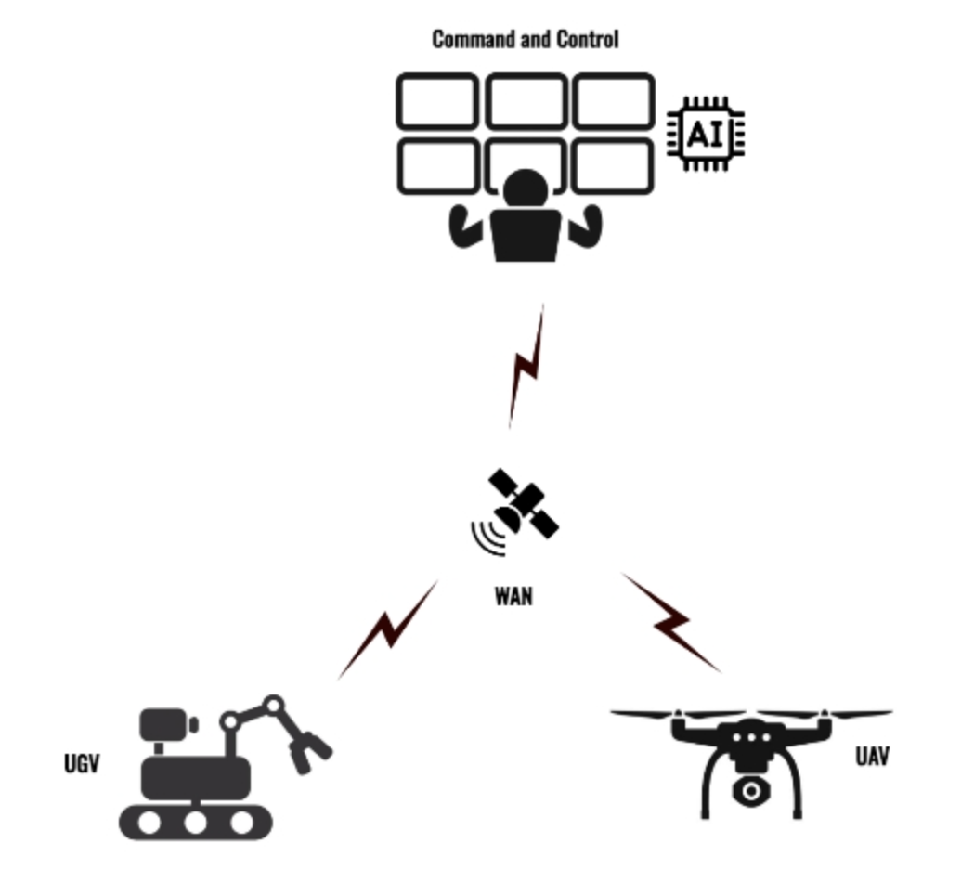
Applying Architectures to Silverfish
SilverFish provides an excellent sandbox to implement several different architectures
Apply the architectures that meet the minimum ethical standards to SilverFish and compare outcomes
We want to understand the performance vs risk tradeoff of each architecture in a variety of operating conditions

Slide 16




